Slide 1


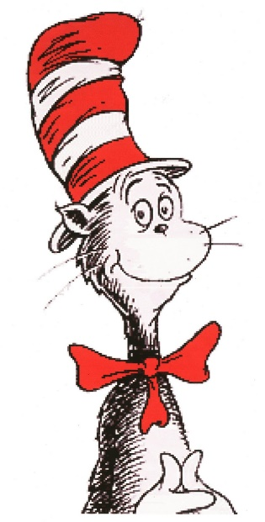
Reading Workshop
September 2020
This Photo by Unknown Author is licensed under CC BY

Slide 2
Research
Involvement in reading by parents/guardians/adults improves academic performance, relationships and health

Slide 3
osmosis
/ɒzˈməʊsɪs/
Learn to pronounce
noun
1.
BIOLOGY•CHEMISTRY
a process by which molecules of a solvent tend to pass through a semipermeable membrane from a less concentrated solution into a more concentrated one.
2.
the process of gradual or unconscious assimilation of ideas, knowledge, etc.
"by some strange political osmosis, private reputations became public"
children do not naturally develop reading skill through exposure to text. ... To read an alphabetic language, children must learn how written letters represent spoken sounds, recognize patterns of letter sounds as words, and match those to spoken words whose meanings they know.

Slide 4
Mongrel Language
In terms of specifics, if you look at the vocabulary of English, 26% of English is Germanic in origin, nearly 30% is French in origin, and nearly 30% Latin
‘dough’, ‘tough’ and ‘bough’—they all have the same spelling, but are pronounced completely differently. This spelling, using ‘-ough,’ is actually a relic from Middle English—Chaucer’s world—where the spelling reflected the Middle English pronunciation. Many of those pronunciations have disappeared over the years, but the spelling remains, for example the ‘ch’ sound in the Scottish word ‘loch’ no longer exists in standard British English pronunciation.

Slide 5
Words like “sign” and “bomb” are difficult because of their silent letters, but these hint at relationships with other words. The connection with words like “signature” and “bombard” is obvious.
In English a letter’s sound often depends on its context within the word. For example, the letter c can sound soft (as in receive) or hard (as in cat). Many words like “yacht” don’t seem to follow any logic at all.

Slide 6
Core Skills
Phonemic awareness – the ability to hear and manipulate the different sounds in words
Phonics – recognising the connection between letters and the sounds they make
Vocabulary – understanding the meaning of words, their definitions, and their context
Reading comprehension – understand the meaning of text, both in storybooks and information books
Fluency – the ability to read aloud with speed, understanding and accuracy

Slide 7
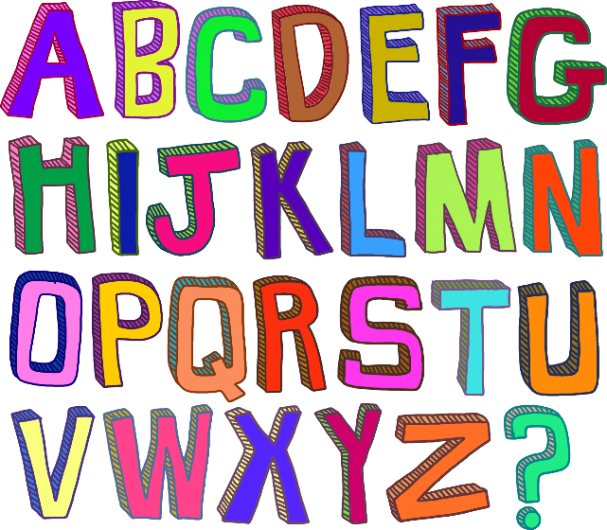
Miss Vukomanovic
Teaching Phonics at Ickford

Slide 8
Letters and sounds
6 phases
Phase 1
Phase 2
Phase 3
Phase 4
Phase 5
Phase 6

Slide 9
Phonics Vocabulary
Phoneme- Sound
Grapheme- How it is written down (letter shape)
Digraph- Two letters that make one sound (ai ee ie oa oo)
Trigraph- Three letters that make one sound (igh ear air ure)

Slide 10
Ss
Aa
Tt
Pp
Ii
Nn

Slide 11
Mm
Dd
Gg
Oo
Cc
Kk

Slide 12
ck
Ee
Uu
Rr
Hh
Bb

Slide 13
ss
ff
ll
will
miss
puff

Slide 14
Jj
Vv
Ww
Xx
Yy
Zz
qu

Slide 15
ch
sh
th
ng
ai
ee

Slide 16
igh
oa
oo
ar
or
ur

Slide 17


ow
oi
ear
air
ure
er

Slide 18
Do not add “u” to sounds
fuat
fat

Slide 19
Do not add “u” to sounds
puig
pig

Slide 20
Do not add “u” to sounds
nuap
nap

Slide 21
Initial and final sounds
ct

Slide 22
cat
Initial
Medial
Final

Slide 23
A child will begin to read by breaking up words into the sounds they see-segmenting.
Then blend the sounds together to read the word.

Slide 24
shop

Slide 25
chip

Slide 26
jump

Slide 27
sing

Slide 28
quack

Slide 29
float

Slide 30
stamp

Slide 31
wind/mill
windmill
Long words - split them up.

Slide 32
lunch/box
lunchbox
Long words -split them up.

Slide 33
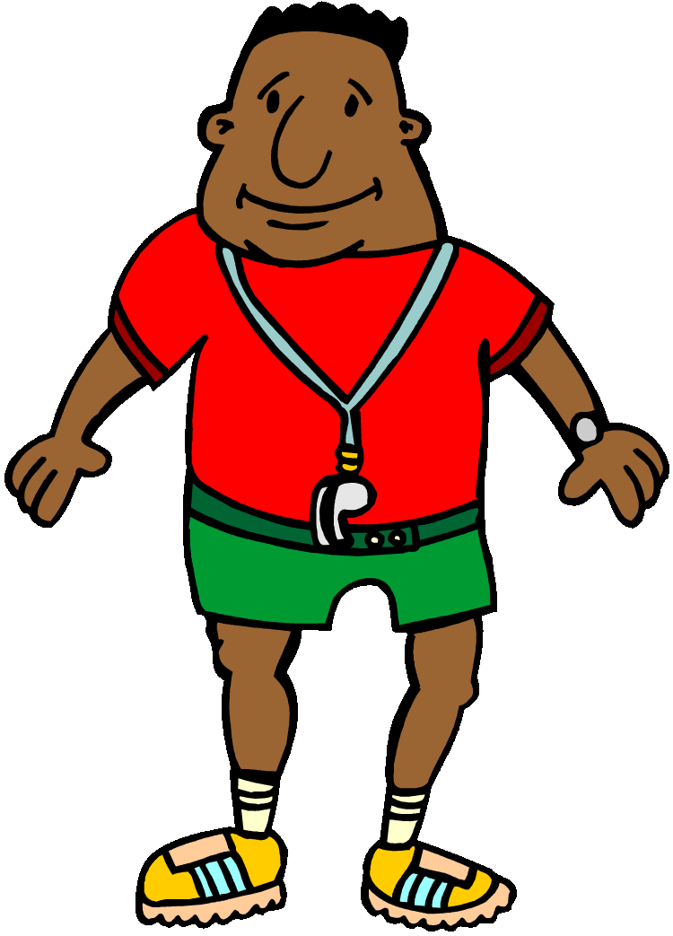
Segmenting and blending
-Georgie’s Gym
-Sounds in the environment
-How many sounds are there in my word?
-Eye spy
t t t table
c c c cup
Ssssssss sandwich

Slide 34
Blends/ clusters
Consonant clusters or blends, are the names given to two or three consonants that appear together in a word. Each consonant retains its sound when blended.
The term cluster refers to the written form.
The term blend refers to the spoken form.
bl – blue
br – bright
pl- play
spr- spring

Slide 35
Phoneme Frames
Breaking up the word into the sounds you hear.
Activity- Phonemes
r
ai
n
i
ng
f
i
sh
i
ng

Slide 36
Word | Phonemes
jump | j | u | m | p
wish | w | i | sh
stamp | s | t | a | m | p
reaching | r | ea | ch | i | ng
girls | g | ir | l | s
fair | f | air
hearing | h | ear | i | ng
hoop | h | oo | p
days | d | ay | s
sea | s | ea
lunchbox | l | u | n | ch | b | o | x
sunny | s | u | nn | y
claw | c | l | aw
ladder | l | a | dd | er
fly | f | l | y
winking | w | i | n | k | i | ng
rain | r | ai | n
rainbow | r | ai | n | b | ow
crayon | c | r | ay | o | n
window | w | i | n | d | ow
floating | f | l | oa | t | i | ng
chimpanzee | ch | i | m | p | a | n | z | ee

Slide 37
High-frequency Words
the
and
a
to
said
in
he
I
of
it
was
you
they
on
she
is
for
at
his
but
that
with
all
we
can
are
up
had
my
her
what
there
out
this
have
went
be
like
some
so
not
then
were
go
little

Slide 38
Tricky words – Words that cannot be sounded out
the
they
you
was

Slide 39
As children move into Year 1 they learn alternate spellings for reading.
ay- day
ou- out
ie- tie
ea- eat
oy- boy
ir- girl
ue- blue
aw- saw
wh- when
ph- photo
ew- new
oe- toe
au-launch

Slide 40


Split digraphs
Not “magic e” – The e is not magic it is actually doing a job. The e is making the vowel say its name.
a e e e i e o e u e
take even time bone cube
snake these like home tube

Slide 41
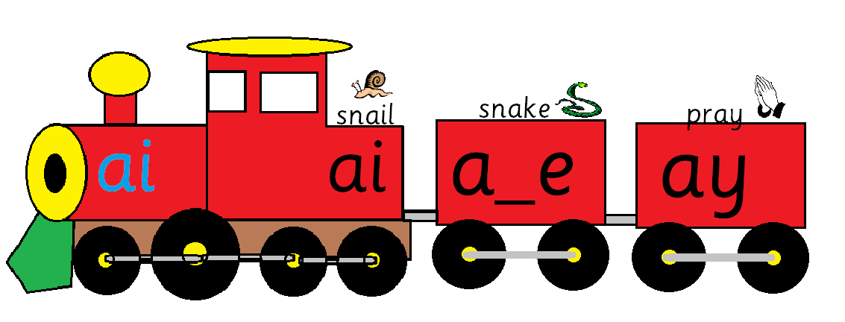
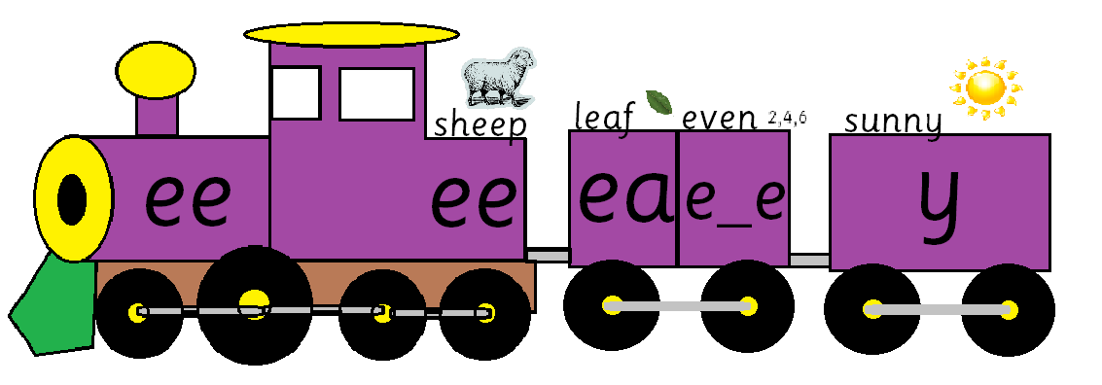
Which sound?

Slide 42
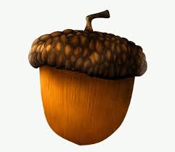




Which spelling?
From Year 1 the children are taught to use the “best fit” rule when spelling a word they are unsure of.
The children are to find all the spellings for the sound they want:
a ai a_e ay ei
ran rain rane rayn rein

Slide 43
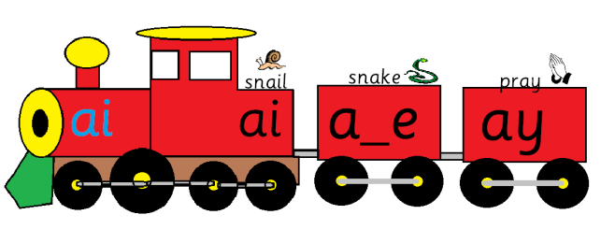
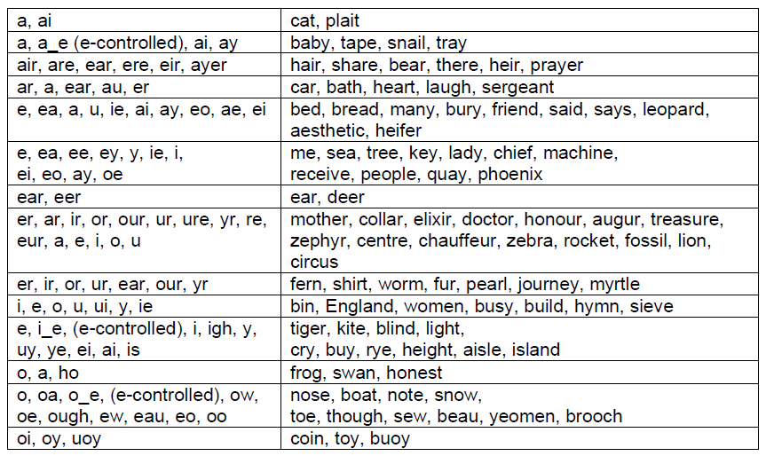

Slide 44
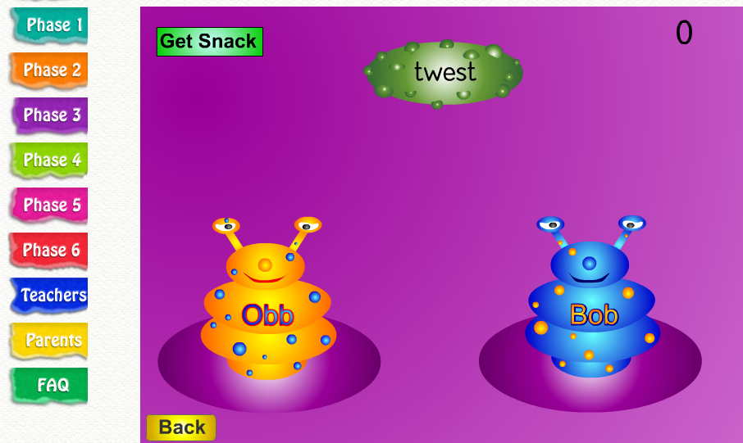
Interactive online Phonic games
www.phonicsplay.co.uk

Slide 45
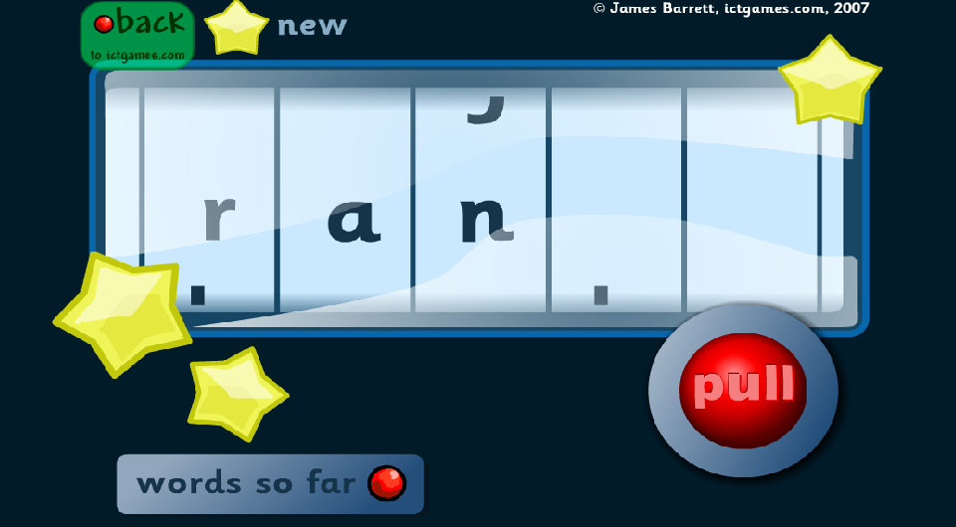
Interactive online Phonic games
http://www.ictgames.com/blendingBingo_LS.html

Slide 46
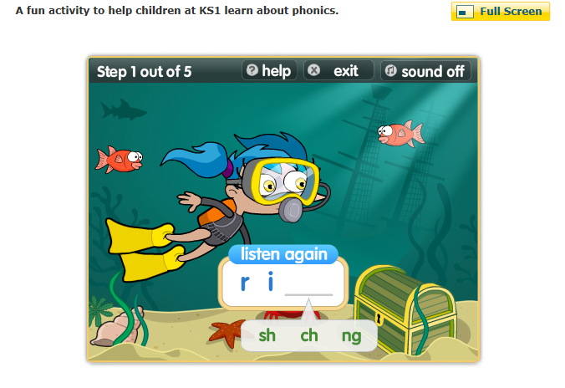
Interactive online Phonic games
http://www.bbc.co.uk/bitesize/ks1/literacy/phonics/play/

Slide 47
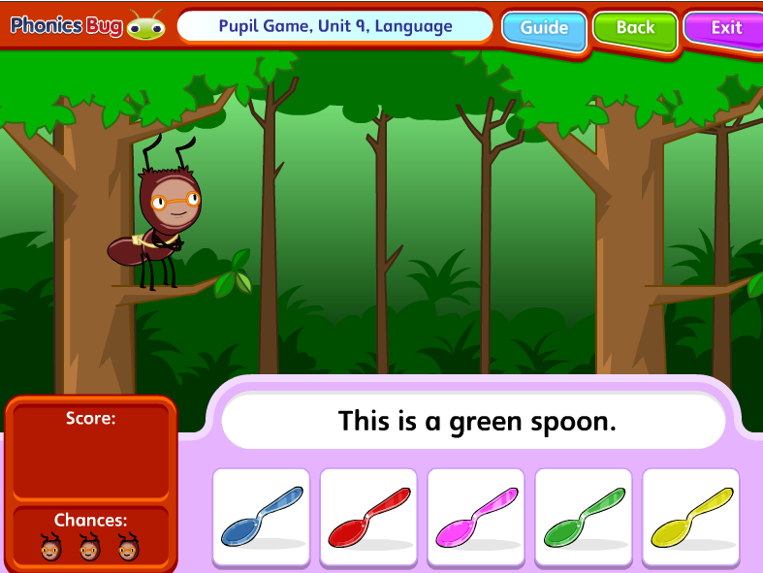
Interactive online Phonic games
http://www.pearsonschoolsandfecolleges.co.uk/demos/aaPrimary/Literacy/Phonics_Microsite_August2011/ElectonicActivity/index.html

Slide 48
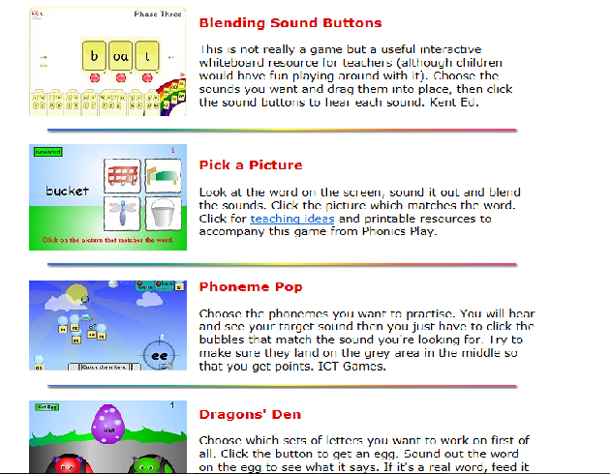
Interactive online Phonic games
www.letters-and-sounds.com

Slide 49
Stages of Reading (Chall 1983)
Children Learn Oral Vocabulary Before They Learn to Read
Pre-reading 6 months – 6 years (thousands of words known meaning of)
1. Initial reading and de-coding (approximately 600 words)
2. Confirmation and fluency (7 – 8 years, easy familiar texts, decode and sight recognition, develop through higher level instruction and listening to others)
3. Reading for learning the new (Read to gain ideas, knowledge, new feelings attitudes, still inclined to learn more through listening comprehension than reading comprehension)
4. Multiple viewpoints (15 – 17 broad subjects differing viewpoints)
5. Construction and re-construction adults, age 18 and up, own purpose, gain knowledge and integrate new knowledge with prior experiences. They can read quickly and efficiently.

Slide 50
Beyond passive listener
Don’t just listen or read to, discuss
Point to pictures and ask questions about them
Share opinions about characters or events
Don’t worry about reading the same thing over again if it’s a favourite

Slide 51
Simple contextual questions (For early reading development)
Who did…?
Where was…?
What did…?
What was…?
Inferential questions (These are higher order reading skills)
Why do you think…?
What did you think of…?
Who was your favourite character…? Why…?
What would you do if…?
What was your favourite part…?
Why was it…?

Slide 52
Some points to remember
Make it fun!
No distractions – cooking, cleaning, chatting, driving
If a book is boring – change it but also encourage to persevere
(Difference between school and pleasure)
If they struggle with a word, tell them!
Read to children as well as with them (Have them copy/repeat)
Don’t worry if you don’t feel confident they will not know if you make a mistake
Always go back to something they can read –reinforce that they are a reader

Slide 53
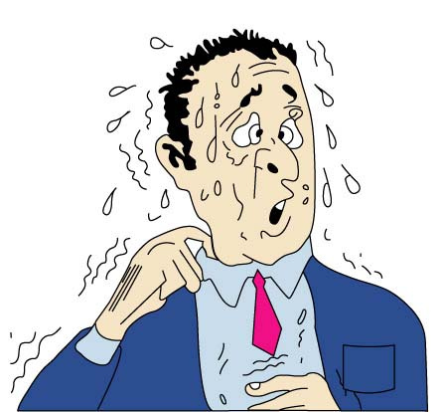
Questions?

